Slide 1

Department of Intelligent Systems
School of Computer Science Engineering
Lovely Professional University, Jalandhar December-2022
Marketing Website
Team Members:
Priyam Chaudhary
(12223869)
Anurag Deep
(12222187)
Alok Singh
(12223802)

Slide 2
Introduction
Internet marketing refers to any form of advertising or marketing on the web. It’s an all-inclusive term for promotions shared via emails, social media posts, paid advertisements displayed on search engines, etc. As users get younger, companies have shifted their marketing strategies to the Internet, where they can reach a larger, more relevant audience at lower cost to traditional advertising options.

Slide 3
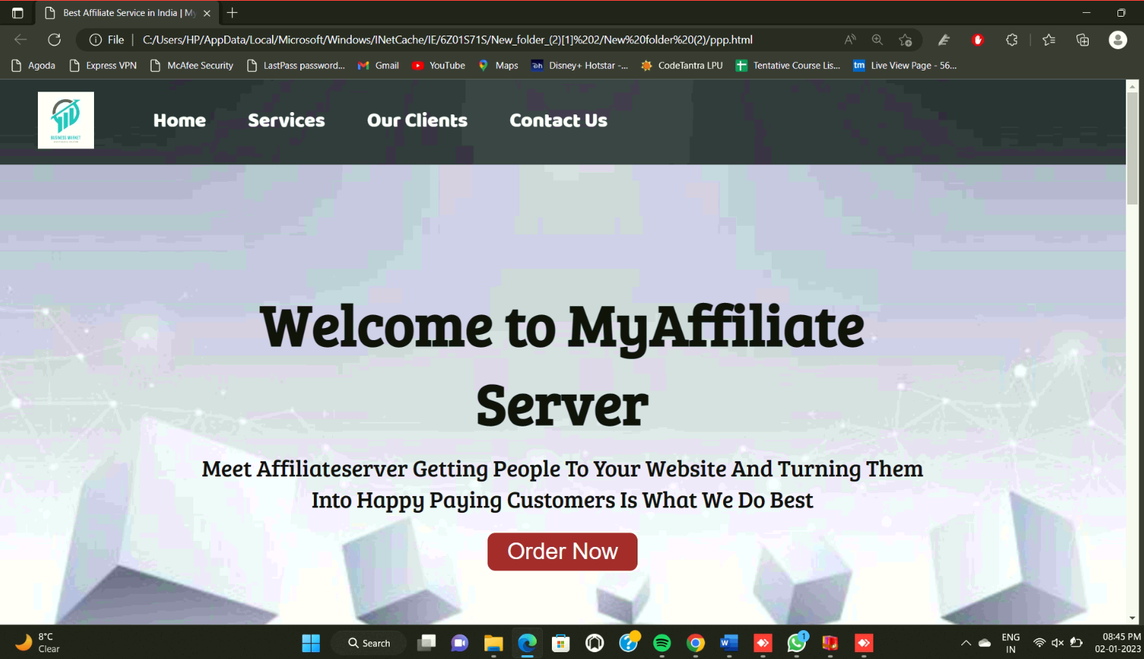
Home

Slide 4
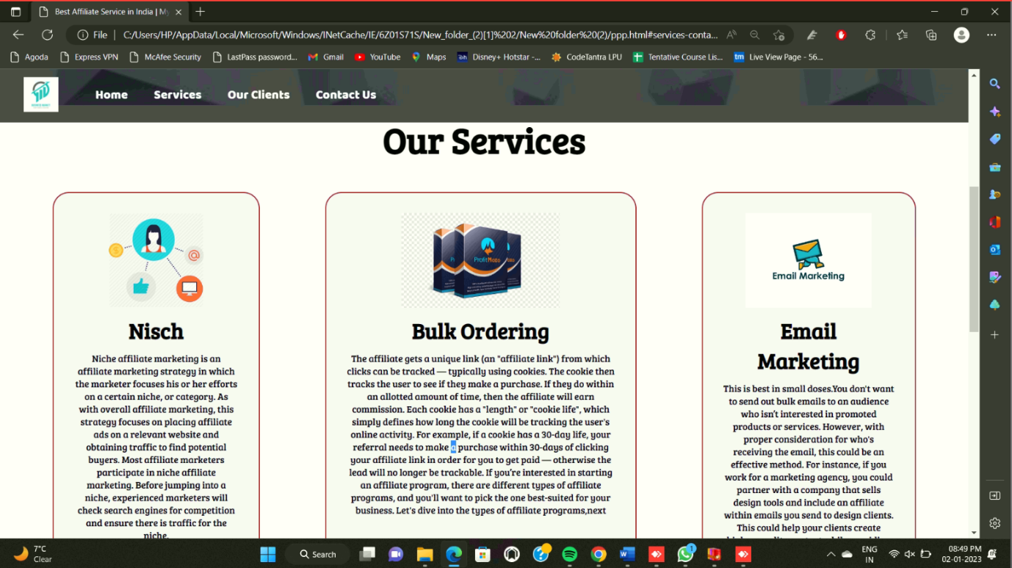
Services:

Slide 5
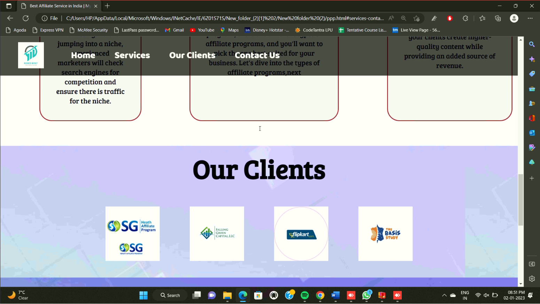
Our Clients:

Slide 6
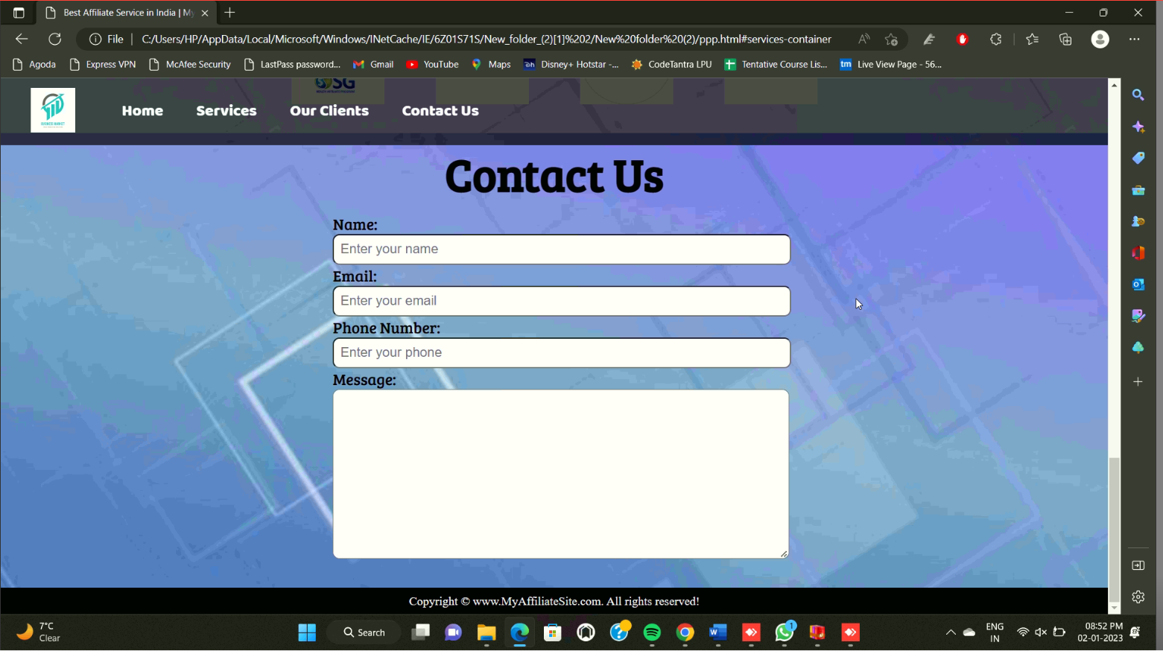
Contact:

Slide 7
TECHNOLOGIES USED
Page layout has been designed in html and css has been used for all the designing part to make this static website.
Home page:
Basic HTML tags,<div>tags with class selector is used to give different styles.
Anchor tag with href attribute is used to design drop down.
Services:
For the description simple <p> tag is used. Start button is given using <a href=“btn”>
Our Clients:
For the description simple <p> tag is used. Basic HTML tags to give description . Image tag, div tags with class selector , and to separate out section tag is used.
Contact :
Using HTML forms property the interface has been designed to get users details.
Also some of the class selectors with <div> tags is used to give certain design.

Slide 8
Conclusion:
MARKETING IS the most exciting of all business sports. It is the heartbeat of every successful business. It is continually changing in response to the explosion of information, the expansion of technology, and the aggressiveness of competition, at all levels and everywhere.

Slide 9
ThankYou!!!

